Slide 1
Universal Customer View
Big Data Demonstration

Slide 2
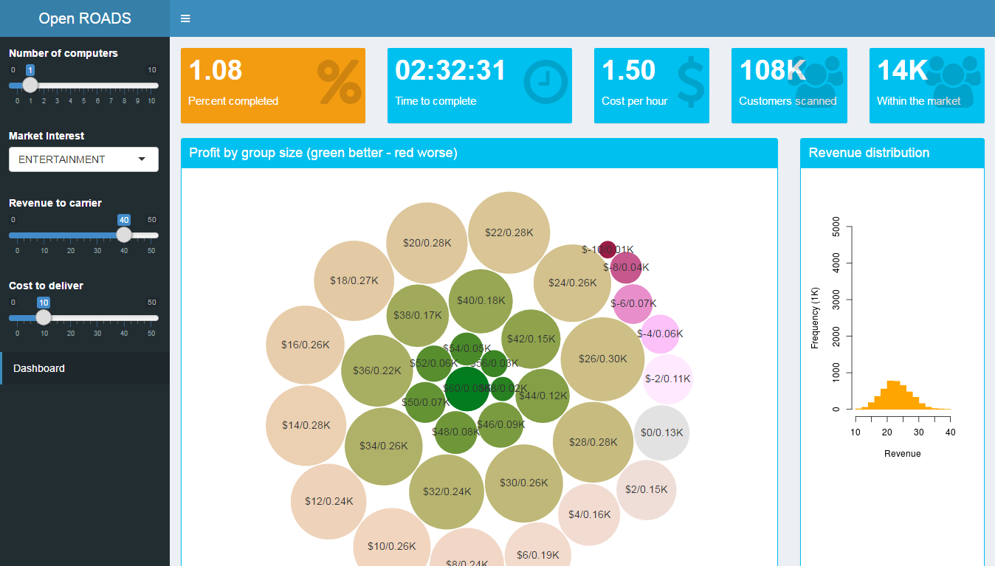
Persona Driven Cross Sell
South Asian operator is running “first month free streaming music service” promotion.
Identify customers, who are likely to continue with their subscription after the promotion period ends.
10M customer CRM records*
100M per service per user records*
External demographic data
Market Interest
Revenue to carrier
Cost to Deliver
Run
Monte Carlo
Simulation
Group customers based
on profit
*Simulated data

Slide 3










Solution Architecture
Microsoft Azure
Data
Storage
Hadoop
Cluster
Controller
UI Shinny
Statistics

